Slide 1
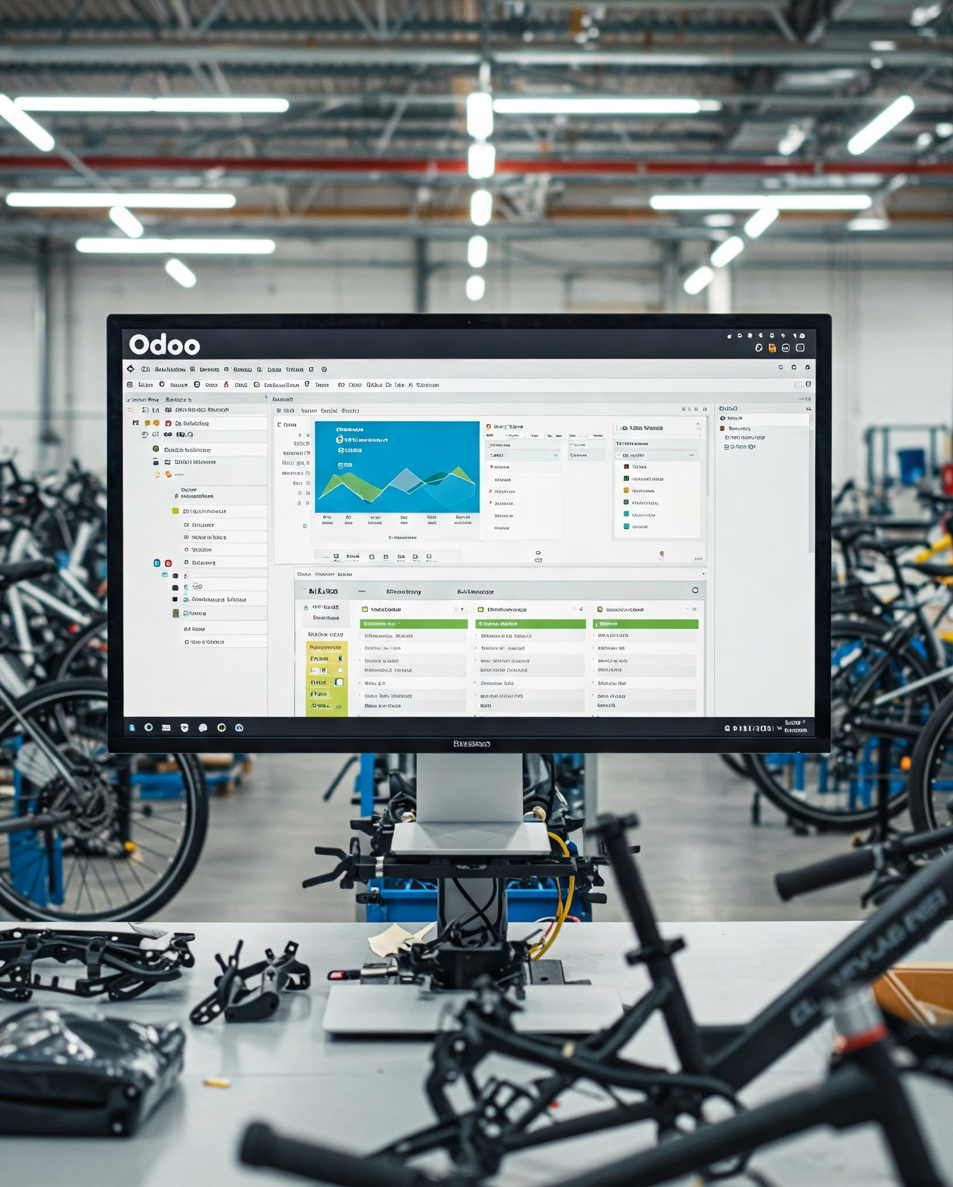
Odoo ERP Presentation for E-Bike Trading
Transforming Operations through Integrated Modules

Slide 2
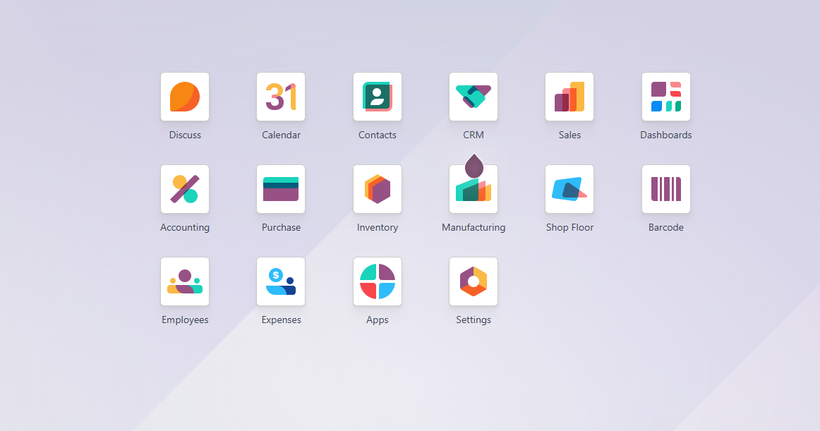
Key Features and Benefits
Odoo offers integrated modules covering inventory, sales, manufacturing, and accounting, providing a single source of truth. These features lead to enhanced productivity, better data visibility, and streamlined communication within the business.

Slide 3
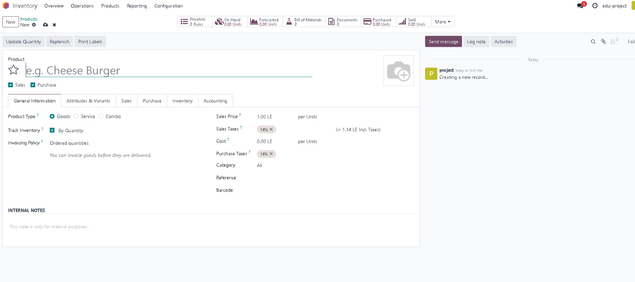
Create a new product.

Slide 4
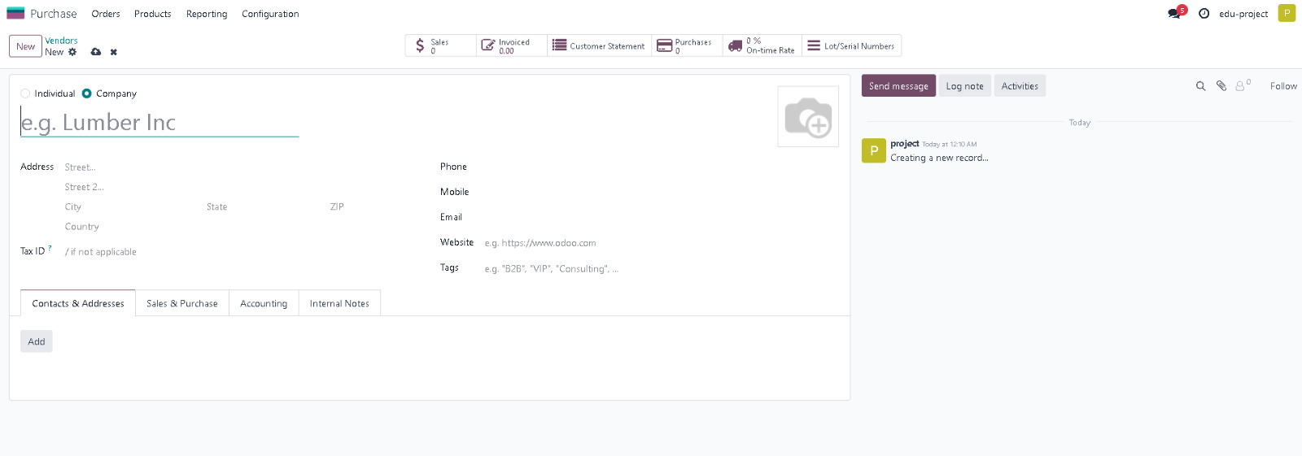
Create a new vendor.

Slide 5
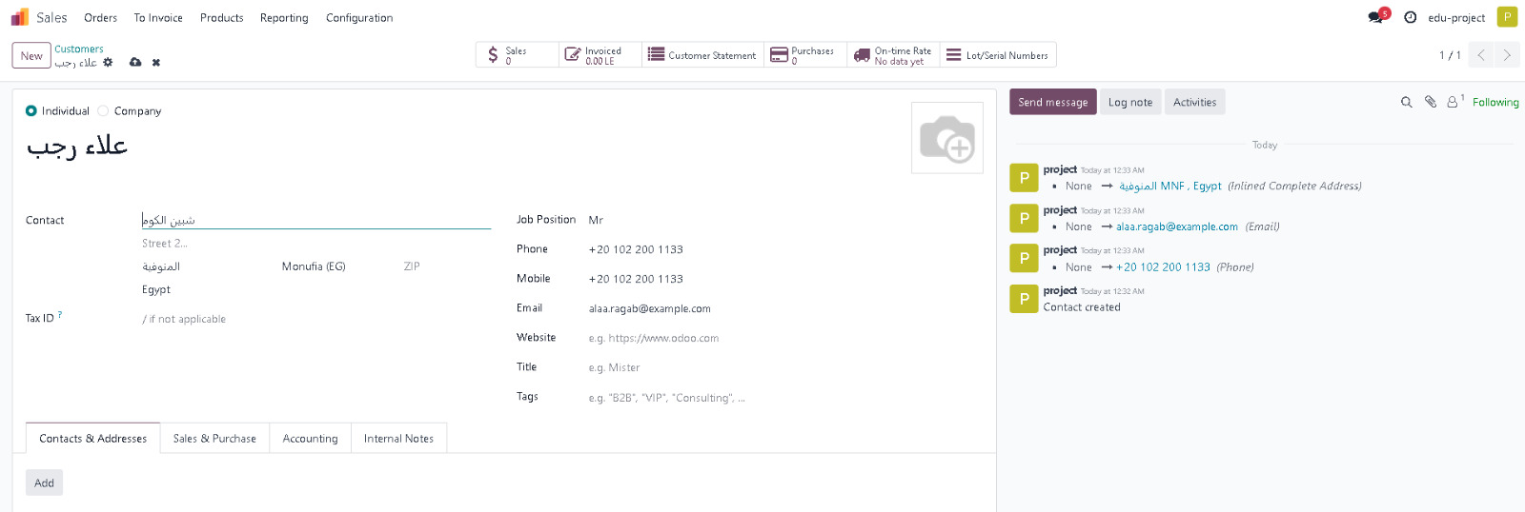
Create a new customer.

Slide 6
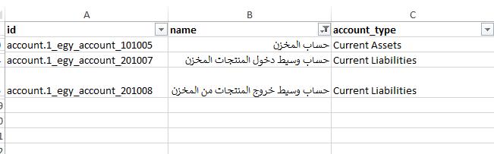
Chart of accounts
"Using Odoo's chart of accounts with modifications to some account names according to the project's usage."

Slide 7
Chart of accounts
"Using Odoo's chart of accounts with modifications to some account names according to the project's usage."

Slide 8
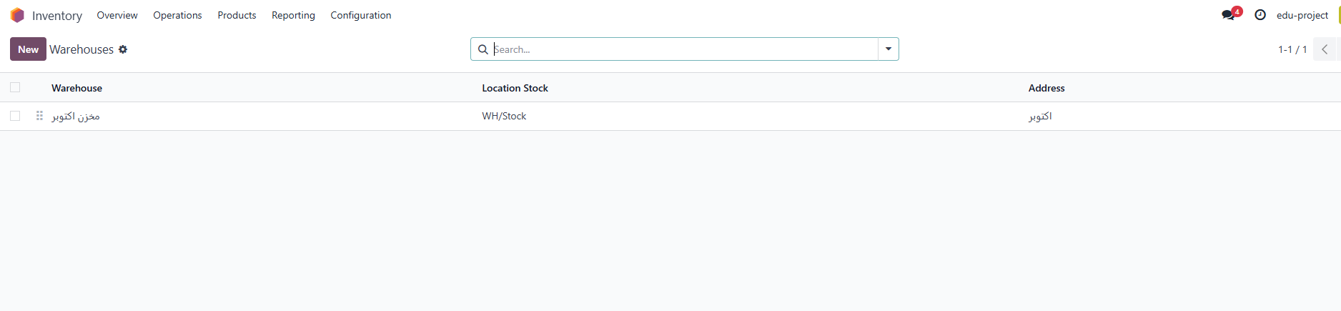
Inventory module
October Warehouse

Slide 9
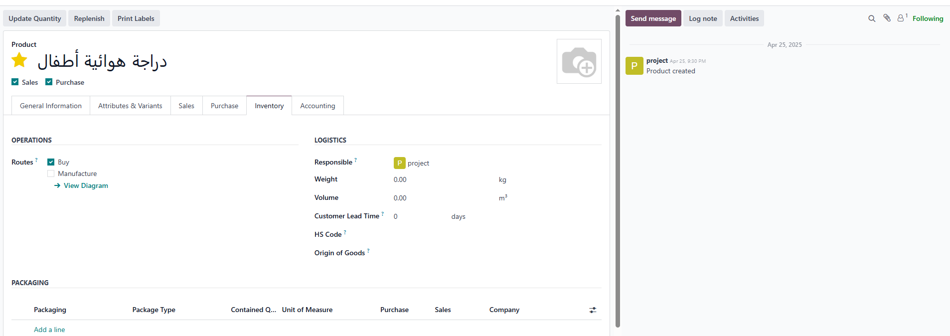
Make To Order
Unlinked MTO

Slide 10
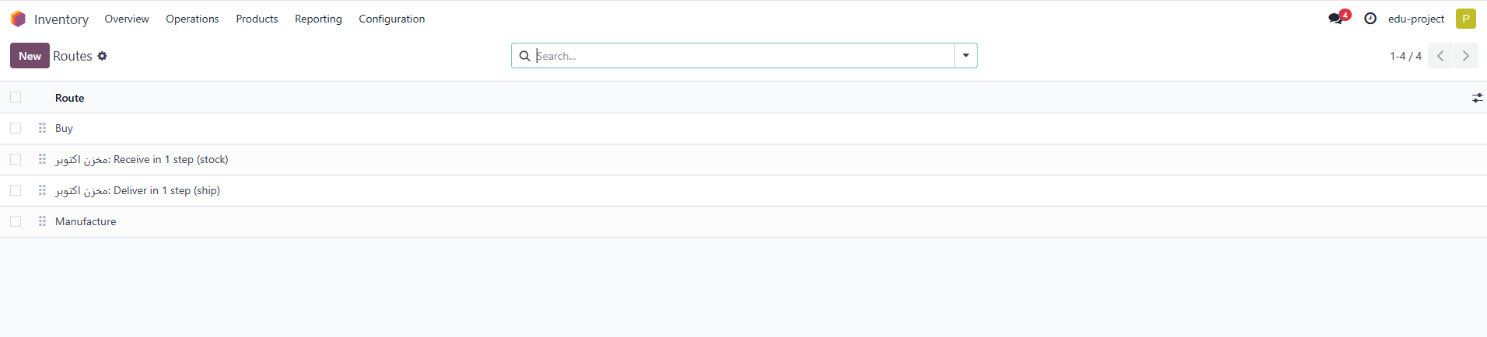
Make To Order
Activating step 1

Slide 11
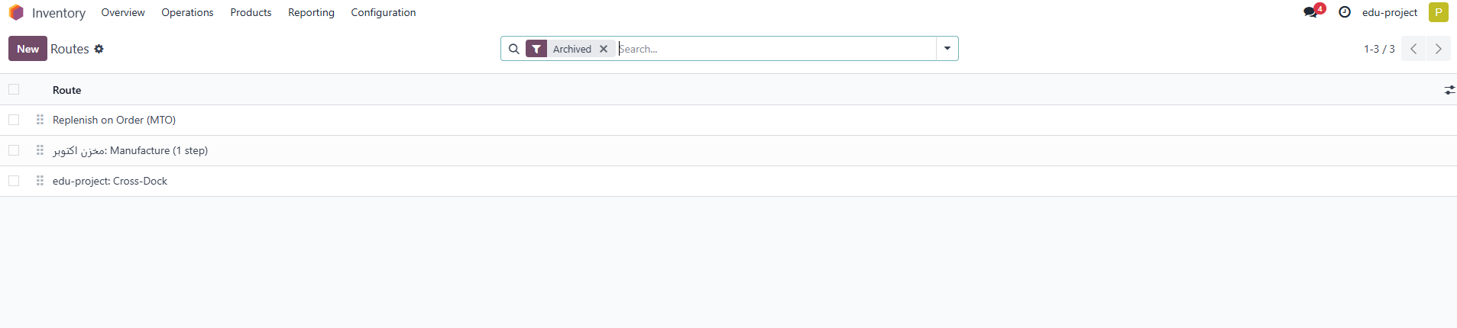
Make To Order
Activating step 2

Slide 12
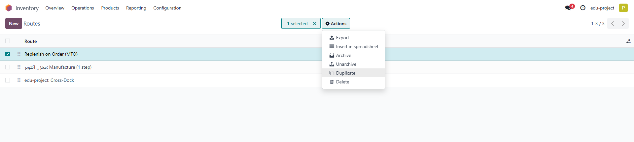
Make To Order
Activating step 3

Slide 13
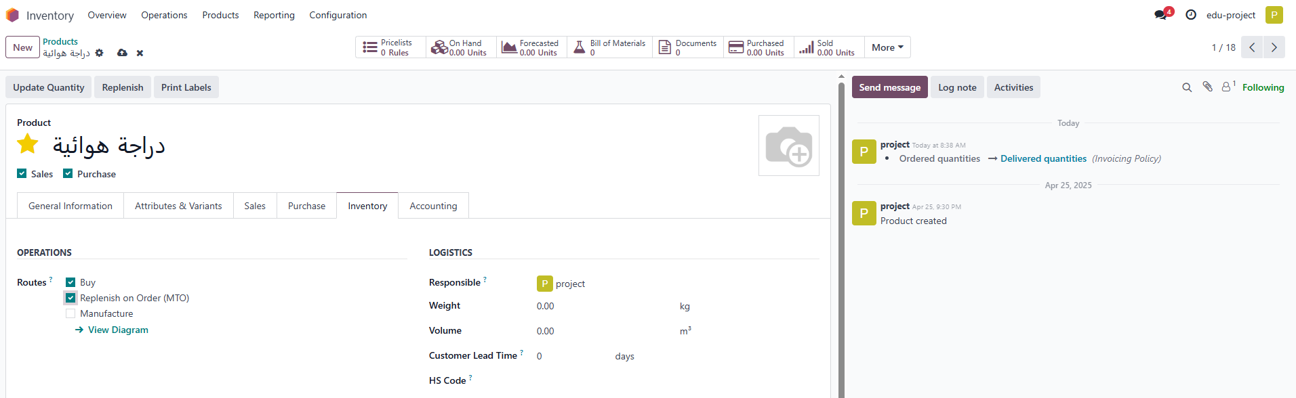
Make To Order
Activating step 4

Slide 14
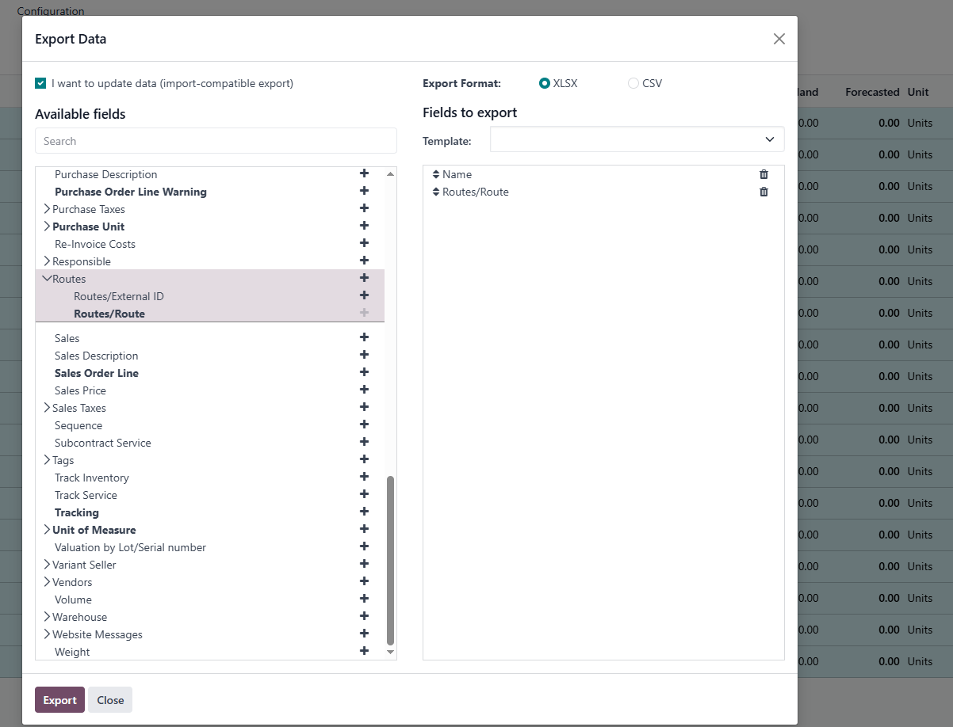
Make To Order
Activating MTO for all products

Slide 15
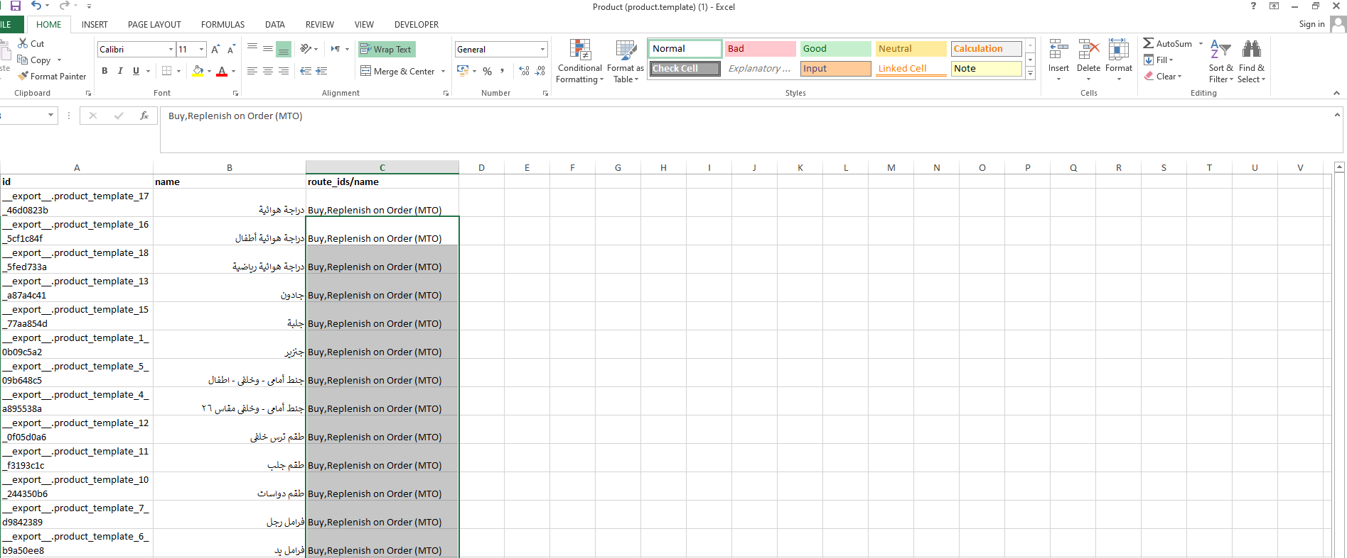
Make To Order
Activating MTO for all products

Slide 16
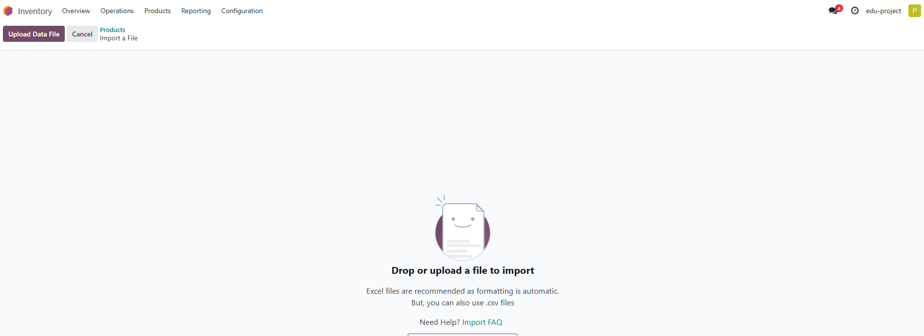
Uploading products after adjusting

Slide 17
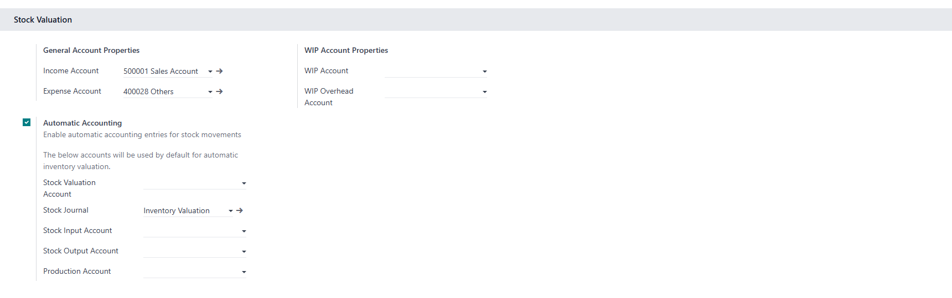
Product category
Activating the product category accounts from the accounting module configuration

Slide 18
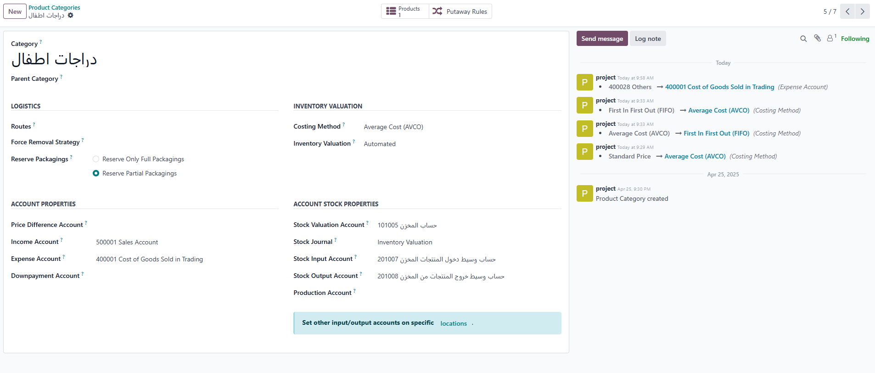
Product category
Click me
Linking the product category with the modified accounts

Slide 19
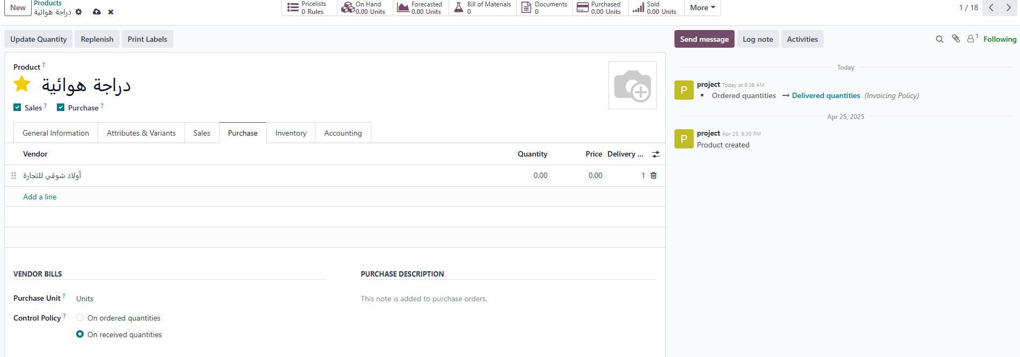
Linking the product with a vendor
This step automates issuing purchase orders

Slide 20
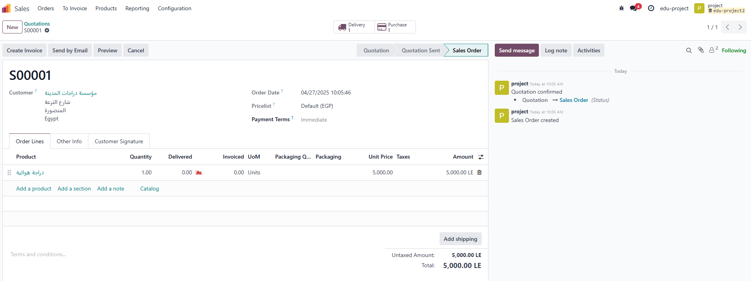
Automatically create a purchase order when there is no quantity available in stock

Slide 21
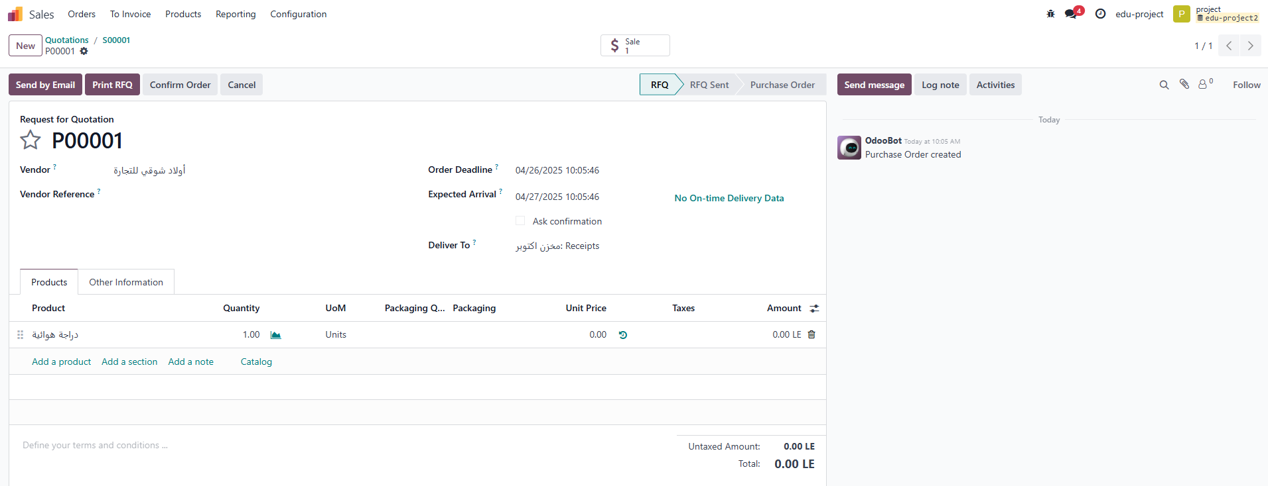
Purchase Orders & Sales Orders are linked

Slide 22
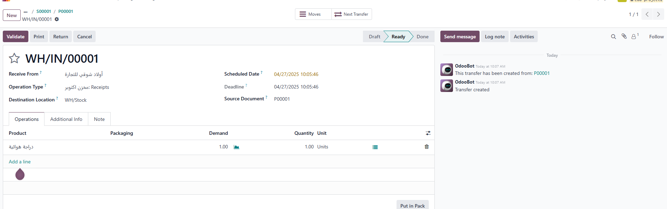
Validating delivery
Warehouse receipt after purchase order confirmation

Slide 23
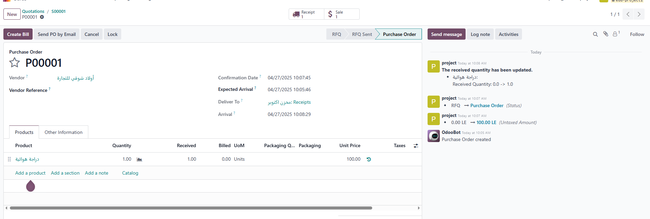
Creating a customer bill
after receiving the product

Slide 24
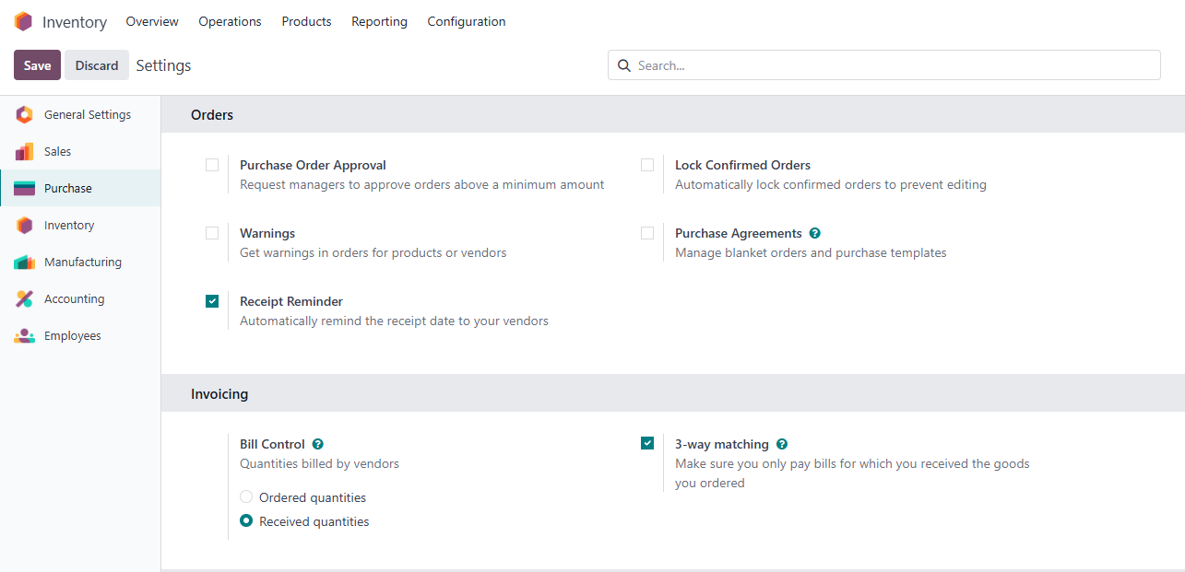
Activating 3-way matching
Ensures vendor bills are only paid once some (or all) of the products included in the PO have been received.

Slide 25
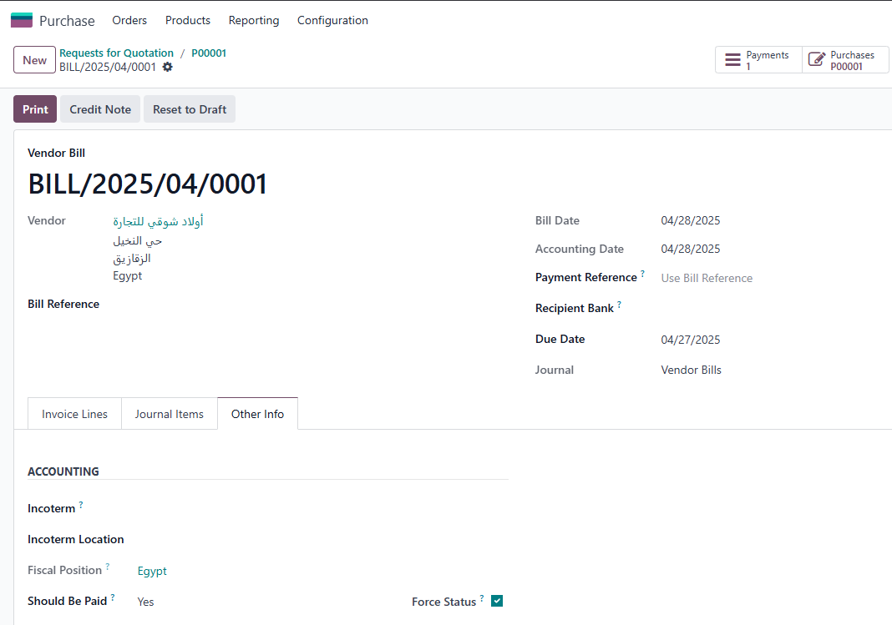
3-way matching

Slide 26
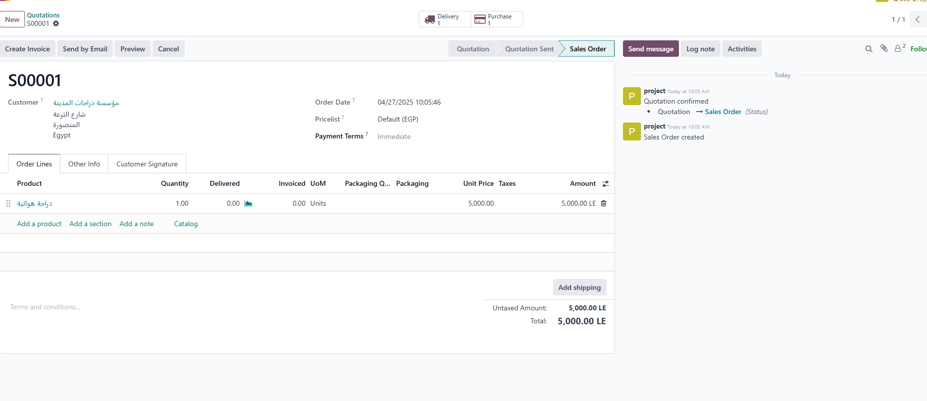
Now the quantity is available in stock

Slide 27
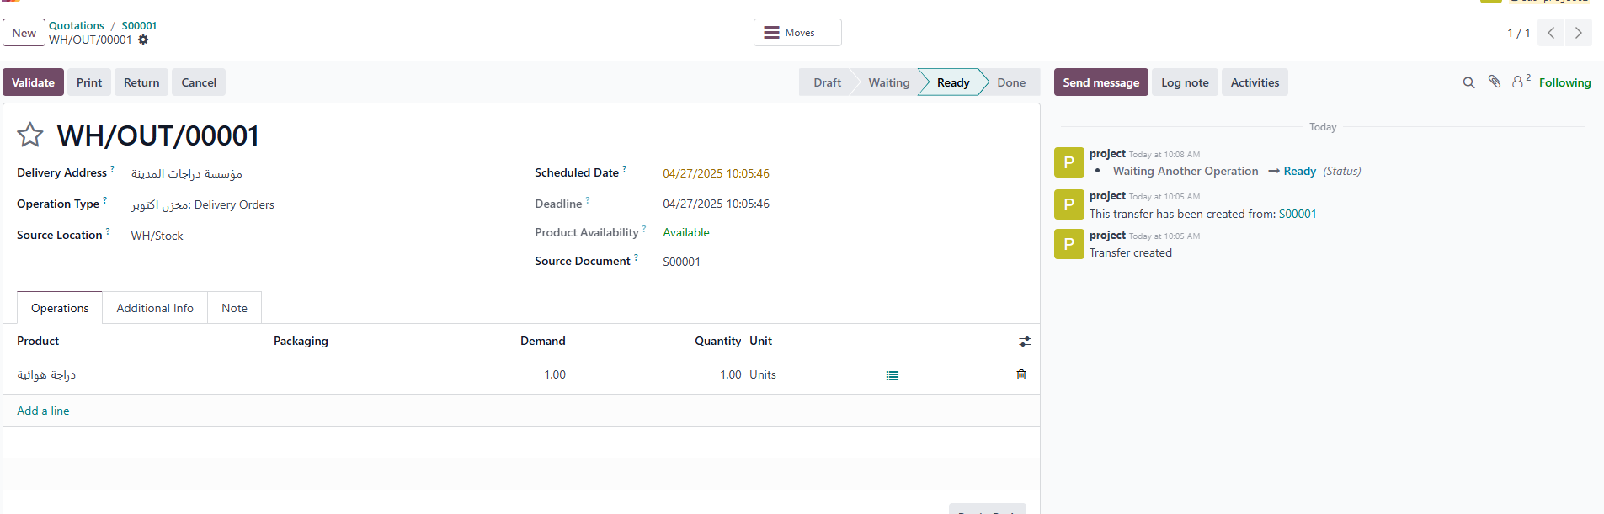
Deliver the product to the customer
Validate the product dispatch from the warehouse.

Slide 28
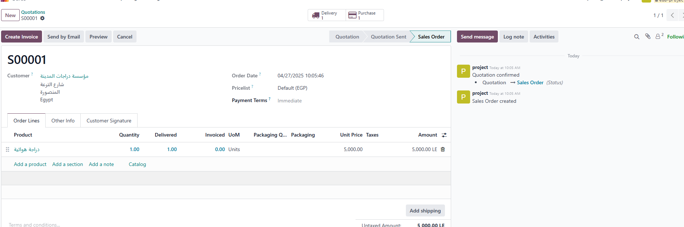
Create customer Invoice

Slide 29
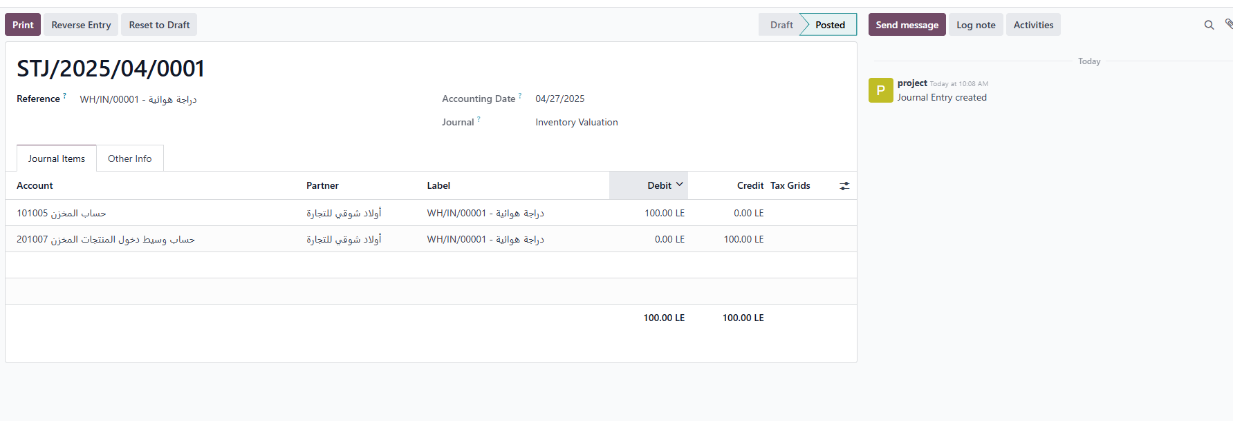
Journal Entry
Product receipt into the warehouse

Slide 30
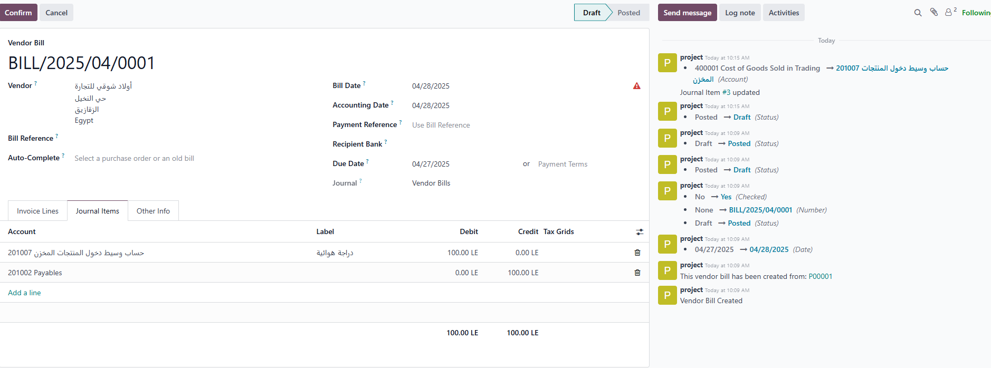
Journal Entry
Issuing vendor bill

Slide 31
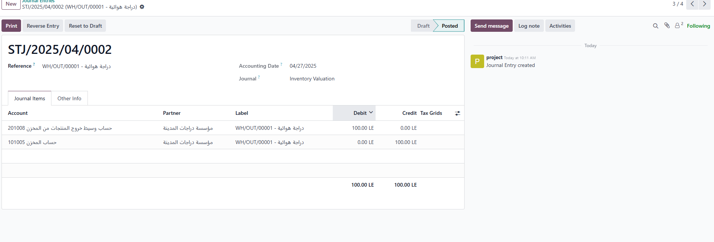
Journal Entry
product delivery from the warehouse to the customer

Slide 32
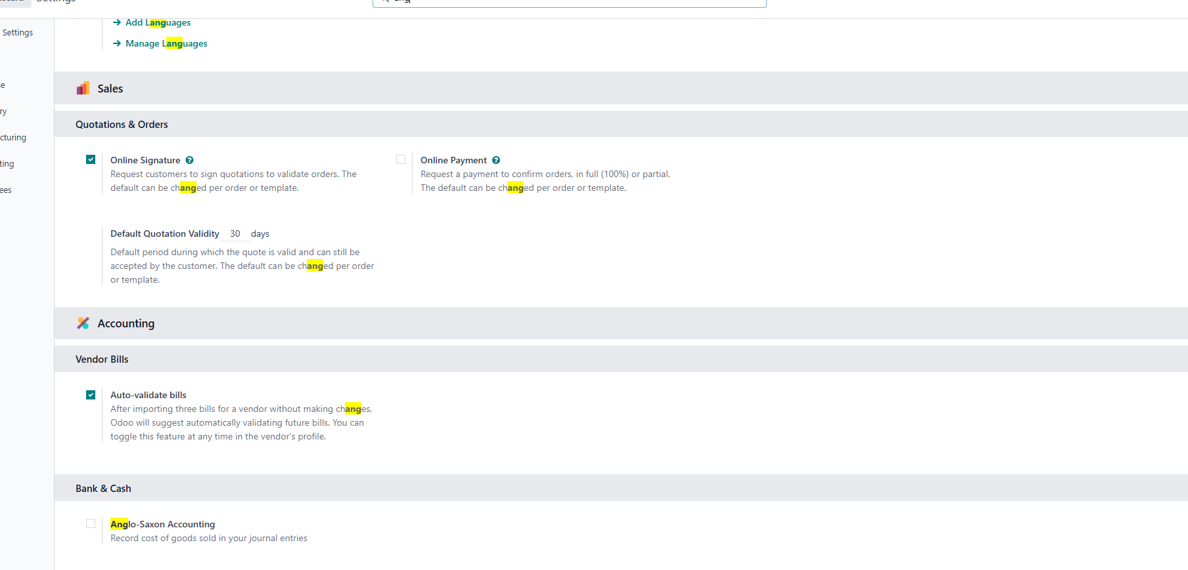
Activating Anglo-Saxon Accounting
COGS is recorded at the time of delivery, not at purchase.

Slide 33
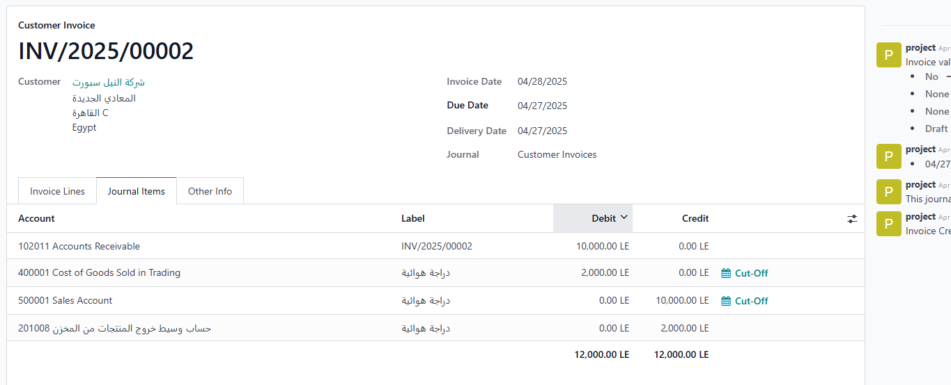
Journal Entry
customer invoice

Slide 34
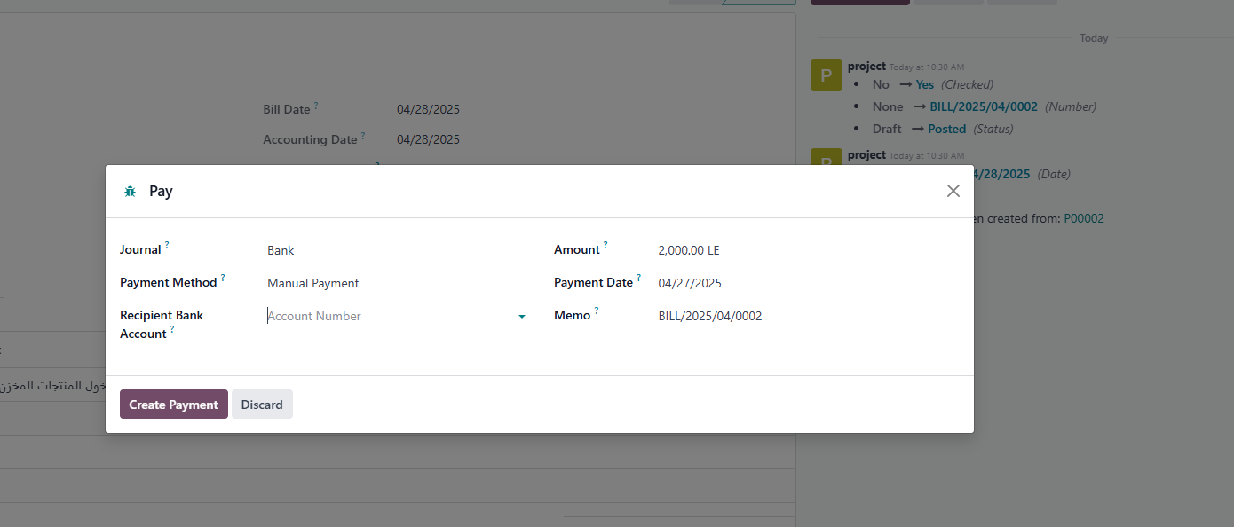
Paying vendor bill

Slide 35
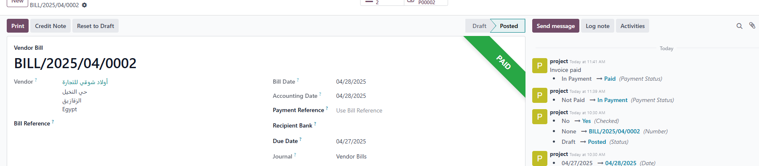
Invoice status after payment

Slide 36
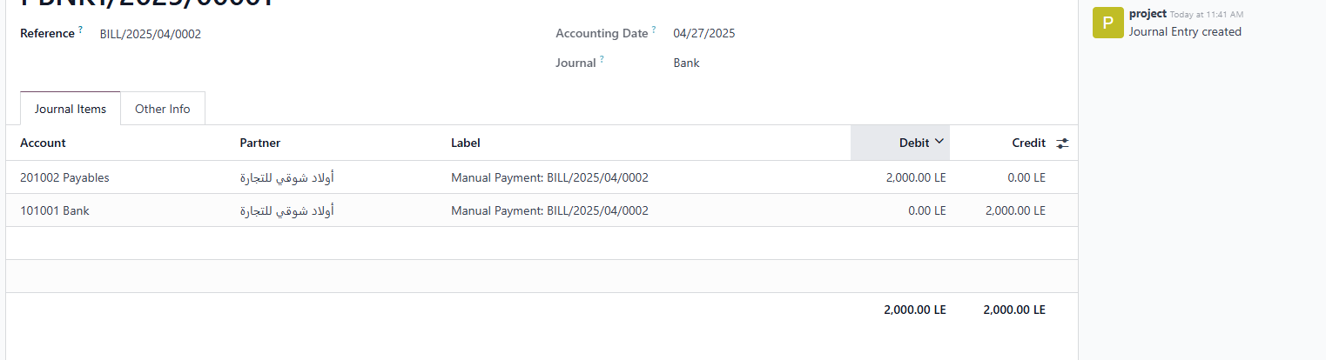
Journal Entry
Invoice payment

